Slide 1

Android Assistant EyeMate for Blind and BlindTracker
Authors
Md. Siddiqur Rahman Tanveer, M.M.A. Hashem and Md. Kowsar Hossain
Department of Computer Science and Engineering (CSE)
Khulna University of Engineering & Technology (KUET)

Slide 2

Blind Mobility
Blind person needs a stick to walk
He needs other’s help to walk in the road
Often blind person gets stumbled in the road not knowing the object
Sometimes blind persons are lost
People ignore blind person as they have to depend on other to go outside

Slide 3
Statistical Information about Blindness
According to World Health Organization blind population
0.4% in industrialized countries
1% in developing countries
As per 2012 there were visually impaired people 285 million
Among them, 246 million had low vision
And 39 million were blind

Slide 4
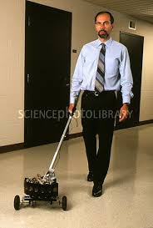
Approaches for Navigating Blind Person
SonicGuide
Geomagnetic sensor
GPS
Vibrator & LED
Silicon Eyes
GuideCane
NavBelt
ActiveBelt

Slide 5
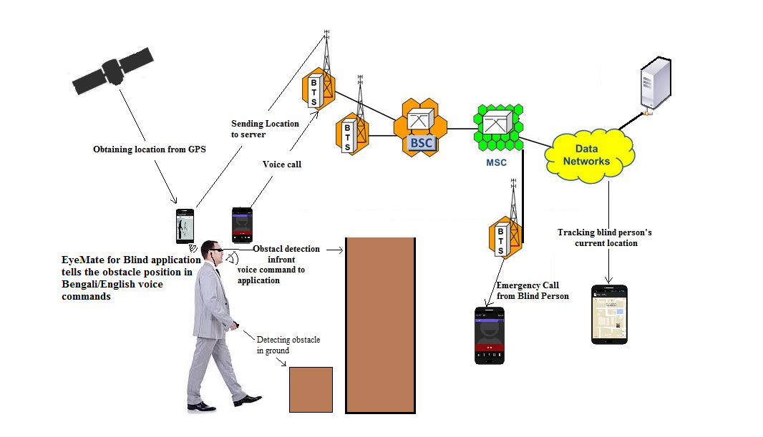
Proposed Solution to Navigate and Track Blind Person

Slide 6
Objectives
Implementing Blind Navigation System through Internet of Things (IoT)
Helping blind person to walk without a stick
Informing blind person about the location of the obstacle
Telling blind person about the location of the obstacle in Bengali language
Blind person can seek emergency help using the EyemateForBlind app
Tracking the location of the blind person
Rescue blind person immediately from any exceptional condition

Slide 7
System Overview
Detects the obstacle
Sends obstacle information to Android phone
Alerts the blind person through Bengali voice commands
Obtains location from GPS
Sends location to server
Stores emergency phone number
Initiates emergency phone call
Retrieves location from server
Points the current location of blind person in Google Map
Obstacle Detecting Spectacle
EyemateForBlind Android Application
Blind Navigation
BlindTracker Android Application
Tracking Blind Person

Slide 8
Functional Block Diagram

Slide 9
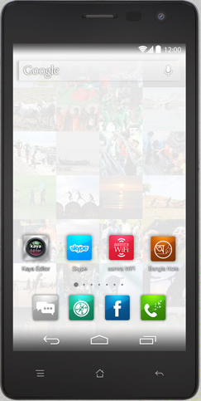
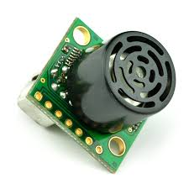
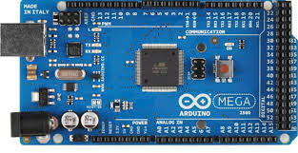
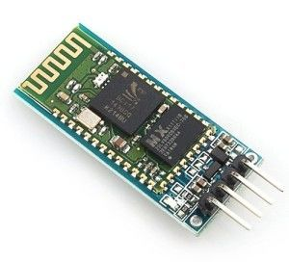
System Components
Android phone
Maxbotix EZ0 range finders
Arduino Mega 2560 development board
HC-05 Bluetooth module
Maxbotix EZ0 Arduino Mega 2560 HC-05 Bluetooth Module

Slide 10
Development Platforms
Android operating system
Apache server
Php
MySQL
Java Script Object Notation (JSON)
Arduino development board

Slide 11
Developing Tools
Android Developer Tools v23.0.2.1259578
Arduino-1.0.5-r2-windows (IDE)
xampp-win32-1.7.4-VC6
jdk-7u17-windows-i586

Slide 12
Obstacle Detecting Spectacle

Slide 13
Obstacle Detection
Rangefinders detect the several distances of the objects
Rangefinder in hand detects the object in ground
Rangefinders in head band detects the object in front
Arduino Mega filters the distances to get the exact distance
Exact result is sent to Android phone using the HC-05 Bluetooth module

Slide 14
Alerting Blind Person about the Obstacle
EyemateForBlind Application Running Algorithm

Slide 15
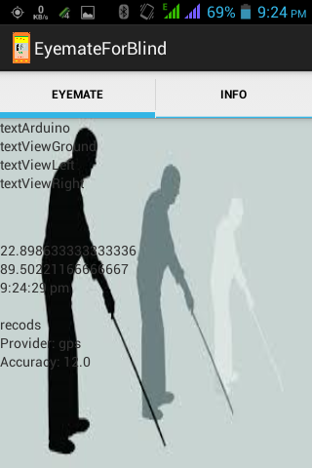
EyemateForBlind
EyemateForBlind app is always ready to receive any signal from hardware module
If any obstacle is detected then Android phone speaks the location of the obstacle in Bengali human speech
Ground obstacle is detected in 60 cm distance
In front obstacle is detected in 100 cm range

Slide 16
EyemateForBlind App Alerts through Voice Commands
Cloud Server

Slide 17
Get Location from GPS and Storing in Server(Cloud Server)

Slide 18
Capturing Location using GPS and Network Provider and Storing Location in Cloud Server
Cloud Server

Slide 19
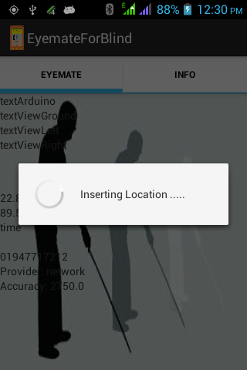
Sending Current Location to Server
Current latitude and longitude are taken dynamically from GPS provider and Network Provider
After 5 minutes location is updated
As soon as the location is updated then it is sent to the server

Slide 20
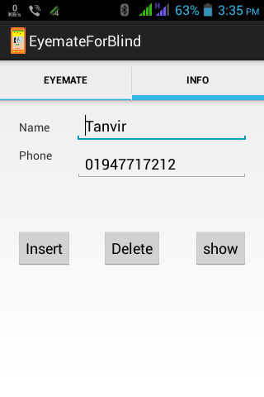
Emergency Phone Number
We can save an emergency number in app so that the blind person can immediately want help by calling that number.

Slide 21
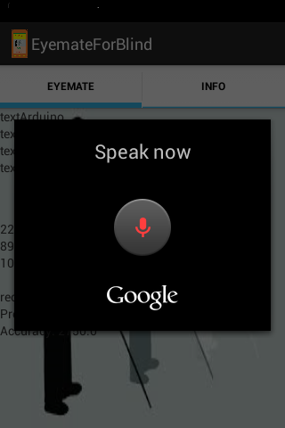
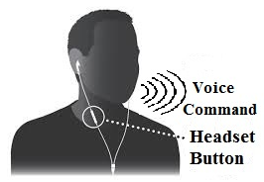
Voice Command by Pressing Headset Button
Blind person needs not touch the phone to operate the app. Just pressing the head set button it can be done

Slide 22
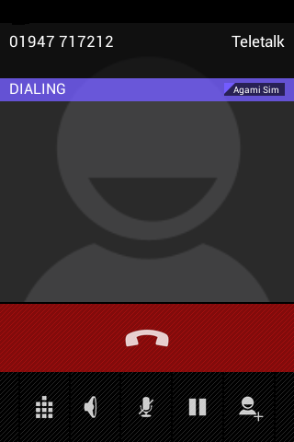
Emergency Phone Calling
Blind person can make emergency phone by voice command in any exceptional condition

Slide 23
Emergency Voice Calling
Emergency Phone Call from
Blind Person

Slide 24
BlindTracker App
After getting the call from the blind person we will go to help the blind person at first getting the position of the blind person by using our Blind Tracker app.

Slide 25
Tracking System
BlindTracker Application Running Algorithm

Slide 26
Tracking Blind Person
Cloud Server

Slide 27
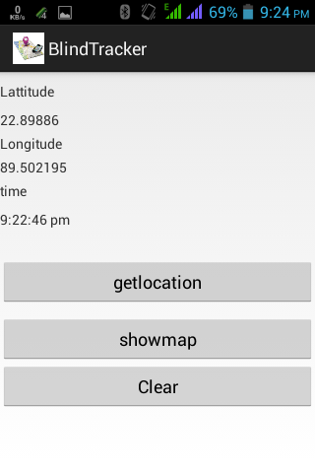
Getting Current location from server
We can get the current location of the blind person from our server.

Slide 28
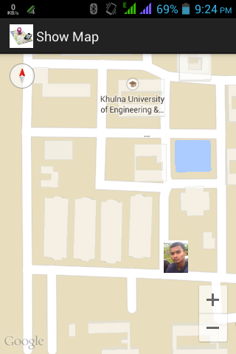
Pointing the location in Google Map
Now we can find the current location of the blind person in the Google map very easily.

Slide 29
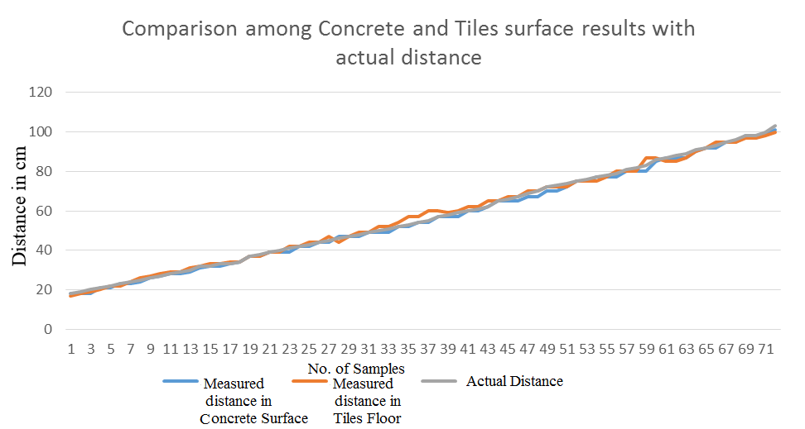
Performance Analysis of Sensing Device

Slide 30
Error Rate of Sensing Device

Slide 31
Final outcomes….
Blind person can walk being aware about the obstacle and doesn’t get hurt.
Blind person won’t need other’s help to go outside
Blind person can seek emergency help without touching his / her phone.
No blind person will be lost since we can track them .
In any odd situation we can reach to him/her very easily and early

Slide 32
References..
[1] Chaudhry M., Kamran M., Afzal S., “Speaking monuments — design and implementation of an RFID based blind friendly environment”, 2nd ICEE International Conf. on 25-26 March, 2008.
[2] Velázquez R., “Wearable Assistive Devices for the Blind.” Chapter 17 in A. Lay-Ekuakille & Mukhopadhyay (Eds.), Wearable and Autonomous Biomedical Devices and Systems for Smart ronment: Issues and Character ization, LNEE 75, Springer, 2010, pp 331-349.
[3] World Health Organization (2009) Visual impairment and blindness- Fact Sheet N°282. Available online at: http://www.who.int mediacentre/ factsheets/fs282/en/
[4] Johann B. and Iwan U. “The GuideCane — A Computerized Travel Aid for the Active Guidance of Blind Pedestrians”, Proceedings of the IEEE International Conference on Robotics and Automation, Albuquerque, NM, Apr. 21-27, 1997, pp. 1283-1288.
[5] Sandra M., Nik A. M., Maxim M., Aaron S. “BlindAid: An Electronic Travel Aid for the Blind”, The Robotics Institute, Carnegie Mellon University, Pittsburgh, Pennsylvania 15213.
[6] B.R.Prudhvi and Rishab B. “Silicon Eyes: GPS-GSM based Navigation Assistant for Visually Impaired using Capacitive Touch Braille Keypad and Smart SMS Facility” Computer and Information Technology (WCCIT), World Congress on 2013, Pages: 1-3, DOI: 10.1109/WCCIT

Slide 33
THANK YOU

